Slide 1

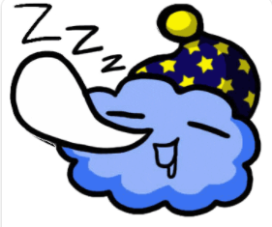

Notes:
How is your sleep?
Good – Congratulations!
Bad – Your are not alone! We will help you

Slide 2
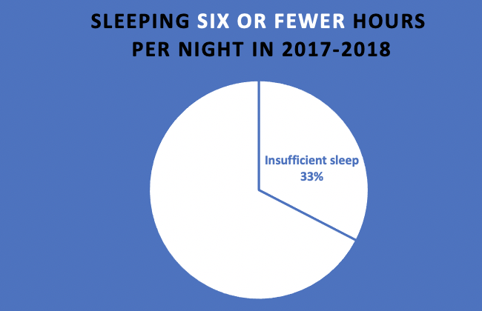

Some Statistics​
32.6%
Insufficient sleep
Notes:
While sleep is too complex to sum up with only numbers, reviewing basic facts and figures about sleep can help you understand how sleep works, why it’s important, and the depth of the sleep deprivation problem
First, about 32.6% of working adults in America reported sleeping six or fewer hours per night in 2017-2018
As for the sleep disorder
Between 10% and 30% of adults struggle with chronic insomnia
Between 30% and 48% of older adults suffer from insomnia
Moreover, 40% of people with insomnia are believed to also be affected by a mental health disorder
Now, let’s dive deeper into sleep.

Slide 3
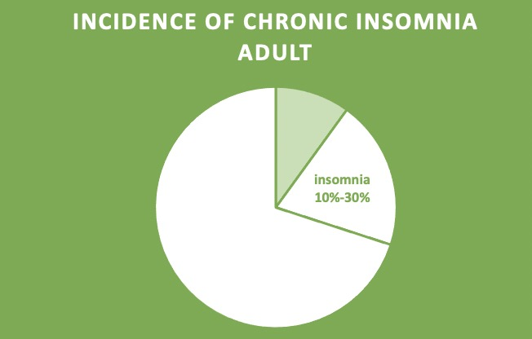
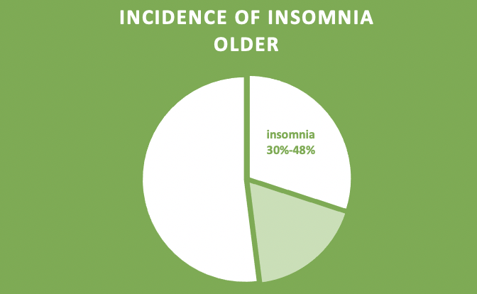
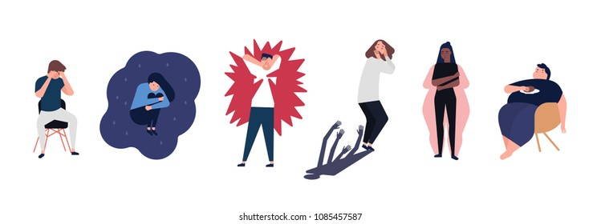
Some Statistics​
Sleep Disorders
10%-30%
30%-48%
40% of people with insomnia has a mental health disorder
Notes:
While sleep is too complex to sum up with only numbers, reviewing basic facts and figures about sleep can help you understand how sleep works, why it’s important, and the depth of the sleep deprivation problem
First, about 32.6% of working adults in America reported sleeping six or fewer hours per night in 2017-2018
As for the sleep disorder
Between 10% and 30% of adults struggle with chronic insomnia
Between 30% and 48% of older adults suffer from insomnia
Moreover, 40% of people with insomnia are believed to also be affected by a mental health disorder
Now, let’s dive deeper into sleep.

Slide 4
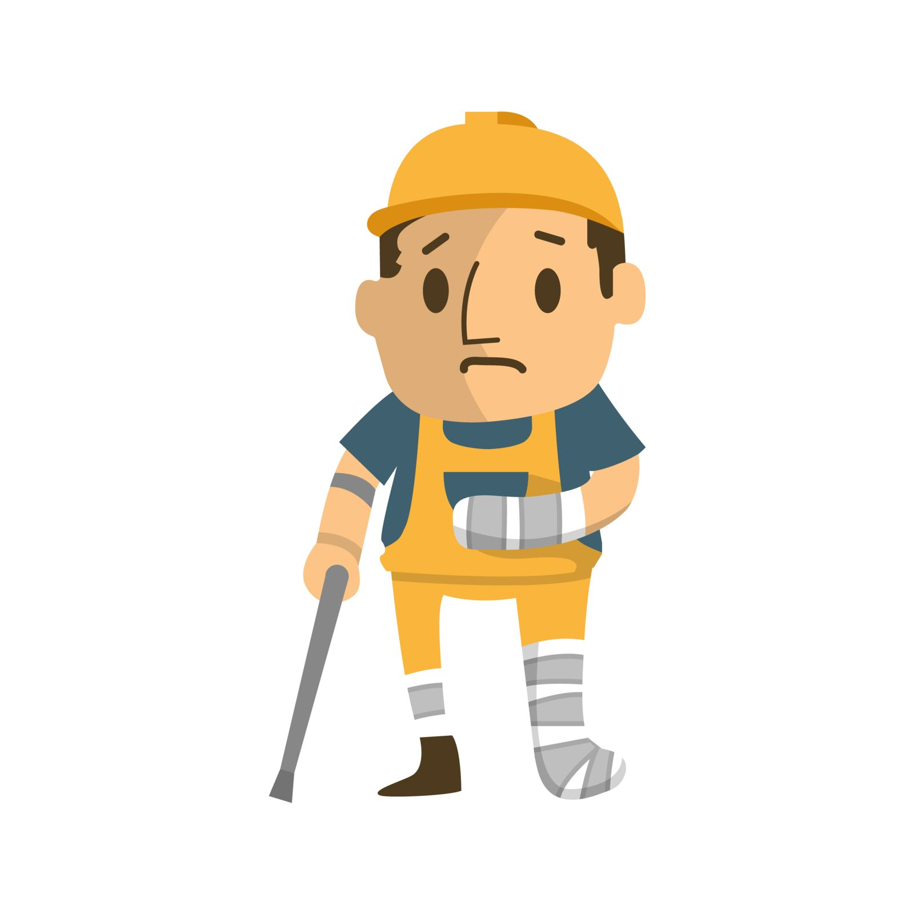
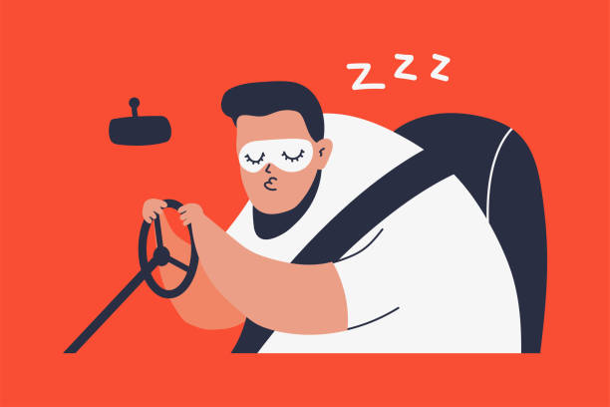
Some Statistics​
Impact of insufficient sleep
Work-related accidents 7x
Drowsy driving 6000 car crashes
Notes:
Insufficient sleep affects daily life a lot
For example, People with severe insomnia are seven times more likely to have work-related accidents than good sleepers
And Drowsy driving is responsible for more than 6,000 fatal car crashes every year in America.
Now, let’s dive deeper into sleep.

Slide 5
Definition of Sleep
Absence of awareness
A state of immobility, with reduced responsiveness, rapid reversibility, and rebound.
Notes:
In our daily life, we may simply define sleep as an absence of awareness. However, in science, there is a complex and fascinating world of sleep. Sleep could be defined as a state of immobility, with reduced responsiveness, rapid reversibility, and rebound. The reversibility states that people can always be awoken with a stimulus at a given intensity. For example, someone may shout loudly of shake your body to wake you up. Rebound means that people will sleep longer if they did not sleep enough recently.
Reversibility simply states that a sleeper can always be awoken with a stimulus at a given intensity.
Rebound is a term used to describe the increase of a sleep variable above normal (or baseline) levels after a period of sleep restriction or deprivation.

Slide 6


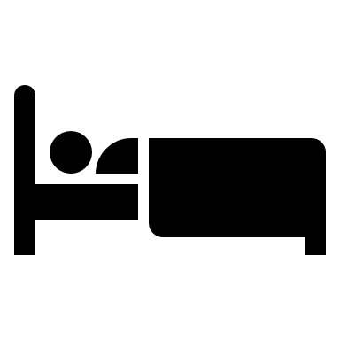
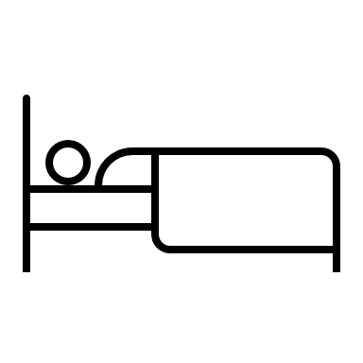
Question time!
How many stages do you think there are in sleep?

